Slide 1
Jeopardy
Review 1
Review 2
Review 3
Review 4
Review 5
$100
$100
$100
$100
$100
$200
$200
$200
$200
$200
$300
$300
$300
$300
$300
$400
$400
$400
$400
$400
$500
$500
$500
$500
$500

Slide 2
$100 Question from Review 1
What is the hypothesis of the following conditional statement?
If the kerfda is a qwetzle, then tomorrow happened yesterday.

Slide 3
$100 Answer from Review 1
What is the Hypothesis of the following Conditional statement?
If the kerfda is a qwetzle, then tomorrow happened yesterday.
Answer: The kerfda is a qwetzle.

Slide 4
$200 Question from Review 1
What is the inverse of the following conditional statement?
If I set my alarm, then I will be on time for work.

Slide 5
$200 Answer from Review 1
What is the inverse of the following conditional statement?
If I set my alarm, then I will be on time for work.
Answer: If I do not set my alarm, then I will not be on time for work.

Slide 6
$300 Question from Review 1
Draw a conclusion and state what you used to do so.
If I set my alarm, then I will be on time for work.
I set my alarm.

Slide 7
$300 Answer from Review 1
Draw a conclusion and state what you used to do so.
If I set my alarm, then I will be on time for work.
I set my alarm.
Answer: I will be on time for work.
Law of Detachment

Slide 8
$400 Question from Review 1
Give either the justification or statement for each step.
Statements | Justifications
1. 60x -5(3x + 2) = 15x -7 2. 60x -15x -10 = 15x -7 3. 45x -10 = 15x -7 4. 5. 30x = 3 6. x = 1/10 | 1. 2. 3. 4. Addition Property of Equality 5. 6.

Slide 9
$400 Answer from Review 1
Statements | Justifications
1. 60x -5(3x + 2) = 15x -7 2. 60x -15x -10 = 15x -7 3. 45x -10 = 15x -7 4. 45x = 15x +3 5. 30x = 3 6. x = 1/10 | 1. Given 2. Distributive Property 3. Adding like terms( something similar) 4. Addition Property of Equality 5. Subtraction Property of Equality 6. Division Property of Equality

Slide 10
$500 Question from Review 1
Use a two column proof to show that
$\frac{17}{x−5}=16$ ⇾ x = $\frac{97}{16}$ is true.

Slide 11
$500 Answer from Review 1
Statements | Justifications
1. $\frac{17}{x−5}= 16$ 2. 17 = 16(x – 5) 3. 17 = 16x - 80 4. 97 = 16x 5. $\frac{97}{16}=x$ | 1. Given 2. Multiplication Property of Equality 3. Distributive Property 4. Addition Property of Equality 5. Division Property of Equality

Slide 12
$100 Question from Review 2
What is the P and Q notation for the converse of a conditional statement?

Slide 13
$100 Answer from Review 2
What is the P and Q notation for the converse of a conditional statement?
Answer: Q ⇾ P

Slide 14
$200 Question from Review 2
State the Law of Detachment in your own words.

Slide 15
$200 Answer from Review 2
State the Law of Detachment in your own words.
If a conditional statement P ⇾ Q is true, and the hypothesis P is true, then the conclusion Q is true.

Slide 16
$300 Question from Review 2
Complete the following chart with the given numbers.
0, 5, $\sqrt{7}$, 6 $\frac{2}{3}$, -17, $\sqrt{\frac{9}{16}}$
Whole | Counting | Integers | Real | Irrational | Rational

Slide 17
$300 Answer from Review 2
Whole | Counting | Integers | Real | Irrational | Rational
0 5 | 5 | 0 5 -17 | All of them | $$\sqrt{7}$$ | All except $\sqrt{7}$

Slide 18
$400 Question from Review 2
What conditional statement always has the same truth value as the contrapositive?

Slide 19
$400 Answer from Review 2
What conditional statement always has the same truth value as the contrapositive?
Answer: The original conditional statement

Slide 20
$500 Question from Review 2
Create a Truth Table for
(P ⇾ Q) ^ (Q ⇾R)

Slide 21
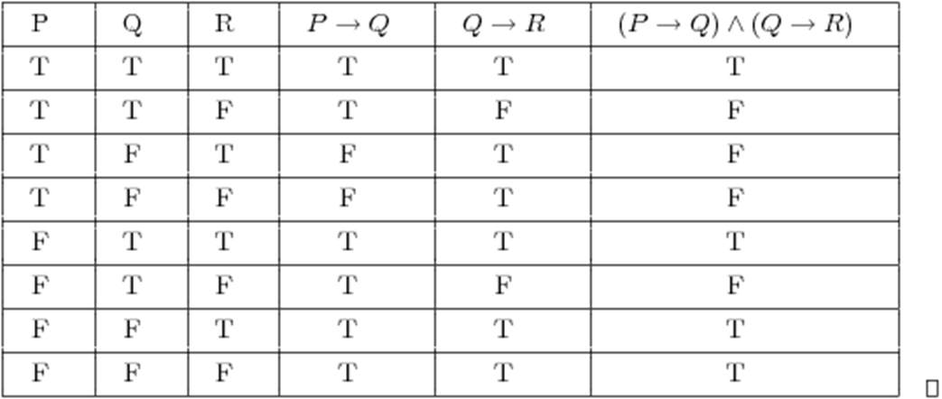
$500 Answer from Review 2

Slide 22
$100 Question from Review 3
What is the P and Q notation for the inverse of a conditional statement?

Slide 23
$100 Answer from Review 3
What is the P and Q notation for the inverse of a conditional statement?
Answer: ~P ⇾ ~Q

Slide 24
$200 Question from Review 3
What is the contrapositive of the following conditional statement?
If I get bored, then I will watch TV.

Slide 25
$200 Answer from Review 3
What is the contrapositive of the following conditional statement?
If I get bored, then I will watch TV.
Answer: If I do not watch TV, then I did not get bored.

Slide 26
$300 Question from Review 3
Draw a conclusion and state what you used to do so.
If it rains, then Jimmy wont go to the park.
If Jimmy doesn’t go to the park, then Jimmy will be sad.

Slide 27
$300 Answer from Review 3
Draw a conclusion and state what you used to do so.
If it rains, then Jimmy wont go to the park.
If Jimmy doesn’t go to the park, then Jimmy will be sad.
Answer: If it rains, then Jimmy will be sad. Law of Syllogism

Slide 28
$400 Question from Review 3
Create a Truth Table for (P ∧ Q) ⇾ (P ∨ Q)

Slide 29
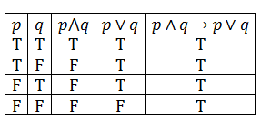
$400 Answer from Review 3

Slide 30
$500 Question from Review 3
Is the following a true biconditional statement? Justify your answer.
Angle A and angle B are vertical angles iff angle A and angle B are equal in measure.

Slide 31
$500 Answer from Review 3
Is the following a true biconditional statement? Justify your answer.
Angle A and angle B are vertical angles iff angle A and angle B are equal in measure.
Answer: No. Not all angles with equal measure form vertical angles. So the Converse is False.

Slide 32
$100 Question from Review 4
What is the P and Q notation for the contrapositive of a conditional statement?

Slide 33
$100 Answer from Review 4
What is the P and Q notation for the contrapositive of a conditional statement?
Answer: ~Q ⇾ ~P

Slide 34
$200 Question from Review 4
State the Law of Syllogism in your own words.

Slide 35
$200 Answer from Review 4
State the Law of Syllogism in your own words.
If P ⇾ Q and Q ⇾ R are true conditional statements, then P ⇾ R is a true conditional statement.

Slide 36
$300 Question from Review 4
Solve the following equation. What type of reasoning did you use?
$x^{2}$ +x – 6 = 0

Slide 37
$300 Answer from Review 4
Solve the following equation. What type of reasoning did you use?
$x^{2}$ +x – 6 = 0
x = -3 or x = 2 Deductive Reasoning

Slide 38
$400 Question from Review 4
What conditional statement always has the same truth value as the inverse?

Slide 39
$400 Answer from Review 4
What conditional statement always has the same truth value as the inverse?
Answer: The converse.

Slide 40
$500 Question from Review 4
Is the following a true biconditional statement? Justify your answer.
x = 3 Iff x³ = 27.

Slide 41
$500 Answer from Review 4
Is the following a true biconditional statement? Justify your answer.
x = 3 Iff x³ = 27.
Answer: Yes. The cube root only produces one answer. So both P ⇾ Q and Q ⇾ P are true.

Slide 42
$100 Question from Review 5
What is the conclusion of the following conditional statement?
If wizerdoodles are square, then spipdols will eat pizza.

Slide 43
$100 Answer from Review 5
What is the conclusion of the following conditional statement?
If wizerdoodles are square, then spipdols will eat pizza.
Answer: Spipdols will eat pizza

Slide 44
$200 Question from Review 5
What is the converse of the following conditional statement?
If I study for the test, then I will pass it.

Slide 45
$200 Answer from Review 5
What is the converse of the following conditional statement?
If I study for the test, then I will pass it.
Answer: If I pass the test, then I studied for it.

Slide 46
$300 Question from Review 5
Find the next two objects in the pattern. What type of reasoning did you use?

Slide 47
$300 Answer from Review 5
Find the next two objects in the pattern. What type of reasoning did you use?
Answer: Inductive Reasoning

Slide 48
$400 Question from Review 5
Write the following as a biconditional statement.
Bob and Mary will only go to the dance with each other.

Slide 49
$400 Answer from Review 5
Write the following as a biconditional statement.
Bob and Mary will only go to the dance with each other.
Answer: Bob and Mary will go to the dance iff they go together.

Slide 50
$500 Question from Review 5
Create a Truth table for (P ∨ Q) ∧ R

Slide 51
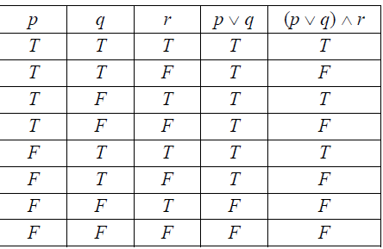
$500 Answer from Review 5

