Slide 1
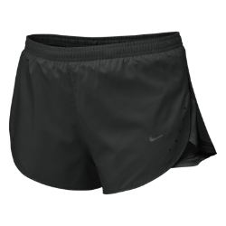
The Shorts Project
Hannah rehman
Fraser high school

Slide 2
Objective
Running shorts were to be measured
Measure 3 different brands of shorts: minimum of 30 pairs (10 of each brand)
Size XS was chosen: XS usually have a measure of 25in
Data will be used to determine which brand is most accurate

Slide 3
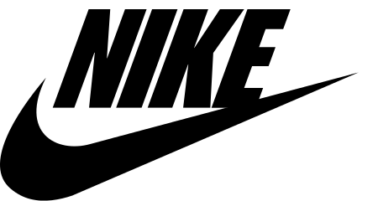
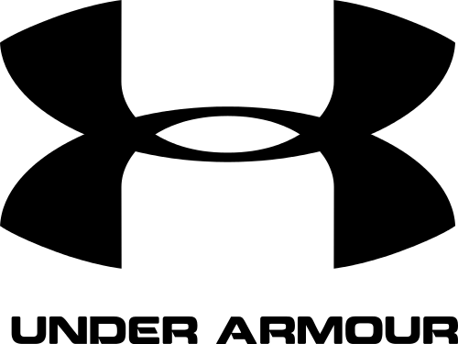
Stores / Brands
Kohl’s-$20
Nike- $32
Under Armor- $25
These were chosen because they were easy to find

Slide 4
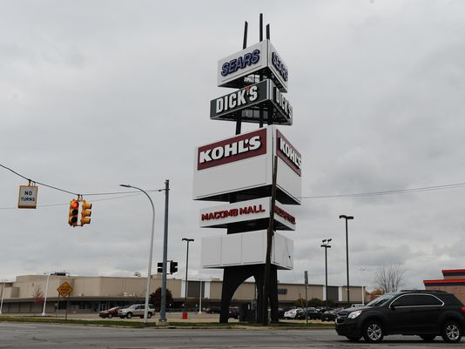
Location
Macomb Mall
Dick’s Sporting Goods

Slide 5
Hypothesis
Nike was hypothesized to be the must accurate
This was thought because Nike is a more popular brand, and it was the most expensive

Slide 6
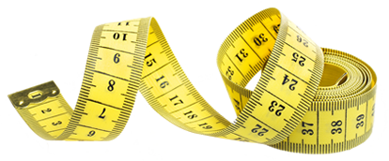
Procedure
Shorts were collected in groups of ten
They were measured around the waistband
It was measured to the nearest tenth of an inch
A tape measure was used to wrap tightly around the waist
Data was recorded after it was measured
This was repeated for each pair

Slide 7
Data
The tables include the size, brand, price, and the average measurement from the brand
The average waist size for the size chosen is also shown in the tables
Data will be shown in the form of tables and charts

Slide 8
Data
 | Brand | Size | Average Waist Size (inches) | Measurement (inches) | Price (dollars)
 | Nike | XS | 25 | 26 | 32
 | Nike | XS | 25 | 25.9 | 32
 | Nike | XS | 25 | 25.8 | 32
 | Nike | XS | 25 | 25.8 | 32
 | Nike | XS | 25 | 24.9 | 32
 | Nike | XS | 25 | 25.6 | 32
 | Nike | XS | 25 | 25.4 | 32
 | Nike | XS | 25 | 25.8 | 32
 | Nike | XS | 25 | 25.2 | 32
 | Nike | XS | 25 | 25.6 | 32
Average | Nike | XS | 25 | 25.6 | 32
10 pairs of running shorts were measured
Mean/Average- 25.6 in
Most expensive- $32
The range of this data was 1.1

Slide 9
Data
 | Brand | Size | Average Waist Size (inches) | Measurement (inches) | Price (dollars)
 | Under Armor | XS | 25 | 28.1 | 25
 | Under Armor | XS | 25 | 27.3 | 25
 | Under Armor | XS | 25 | 28 | 25
 | Under Armor | XS | 25 | 29.2 | 25
 | Under Armor | XS | 25 | 27.9 | 25
 | Under Armor | XS | 25 | 28 | 25
 | Under Armor | XS | 25 | 28.2 | 25
 | Under Armor | XS | 25 | 28.2 | 25
 | Under Armor | XS | 25 | 28.4 | 25
 | Under Armor | XS | 25 | 28 | 25
Average | Under Armor | XS | 25 | 28.13 | 25
10 pairs of running shorts were measured
Mean/Average- 28.13 in
The range of this data was 1.9

Slide 10
Data
 | Store | Size | Average Waist Size (inches) | Measurement (inches) | Price (dollars)
 | Kohl's | XS | 25 | 25.3 | 20
 | Kohl's | XS | 25 | 27.4 | 20
 | Kohl's | XS | 25 | 26.2 | 20
 | Kohl's | XS | 25 | 25.5 | 20
 | Kohl's | XS | 25 | 25.4 | 20
 | Kohl's | XS | 25 | 26.8 | 20
 | Kohl's | XS | 25 | 26.8 | 20
 | Kohl's | XS | 25 | 27 | 20
 | Kohl's | XS | 25 | 25.4 | 20
 | Kohl's | XS | 25 | 25.2 | 20
Average | Kohl's | XS | 25 | 26.1 | 20
10 pairs of running shorts were measured
Mean/Average- 26.1
The range of this data was 2.2
Lease expensive -$20

Slide 11
Data Explained
Kohl’s had the highest range of data at 2.2
Nike had the lowest range at 1.1
Under Armor had a range of 1.9
Under Armor had the highest average at 28.13
Nike had the lowest average at 25.6
Kohl’s had an average at 26.1
The data from the previous slides gives insight that Nike might be the most accurate. The range was the lowest, and the average was closest to the average waist size of an XS, 25.
The next slides will help to determine which brand is truest to size.

Slide 12
Dot Plot

Slide 13
Dot Plot

Slide 14
Dot Plot

Slide 15
Dot Plots Explained
Shows the frequency of each measurement
Shows which measurement/measurements were the most common

Slide 16
Standard Deviation
Shorts Nike | Measurement (x) | Deviation from mean (x-x̄) | Deviation squared (x-x̄)²
1 | 26 | 26 - 25.6 = 0.4 | 0.16
2 | 25.9 | 25.9 - 25.6 = 0.3 | 0.09
3 | 25.8 | 25.8 - 25.6 = 0.2 | 0.04
4 | 25.8 | 25.8 - 25.6 = 0.2 | 0.04
5 | 24.9 | 24.9 - 25.6 = -0.7 | 0.49
6 | 25.6 | 25.6 - 25.6 = 0 | 0
7 | 25.4 | 25.4 - 25.6 = -0.2 | 0.04
8 | 25.8 | 25.8 - 25.6 = 0.2 | 0.04
9 | 25.2 | 25.2 - 25.6 = -0.4 | 0.16
10 | 25.6 | 25.6 - 25.6 = 0 | 0
Total | 25.6 |  | ∑(x-x̄)² = 1.06
Standard Deviation Formula = √∑(x-x̄)²/n-1
= √(1.06) / 10 -1
= √(1.06) / 9
≈ .34
Variance Formula = Standard Deviation Squared
= ≈.34²
≈ .12

Slide 17
Standard Deviation
Shorts Under Armor | Measurement (x) | Deviation from mean (x-x̄) | Deviation squared (x-x̄)²
1 | 28.1 | 28.1 - 28.13 = -0.03 | 0.0009
2 | 27.3 | 27.3 - 28.13 = -0.83 | 0.6889
3 | 28 | 28 - 28.13 = -0.13 | 0.0169
4 | 29.2 | 29.2 -28.13 = 1.07 | 1.1449
5 | 27.9 | 27.9 -28.13 = -0.23 | 0.0529
6 | 28 | 28 - 28.13 = -0.13 | 0.0169
7 | 28.2 | 28.2 -28.13 = 0.07 | 0.0049
8 | 28.2 | 28.2 -28.13 = 0.07 | 0.0049
9 | 28.4 | 28.4 -28.13 = 0.27 | 0.0729
10 | 28 | 28 - 28.13 = -0.13 | 0.0169
Total | 28.13 |  | ∑(x-x̄)² = 2.021
Standard Deviation Formula = √∑(x-x̄)²/n-1
= √(2.021) / 10 -1
= √(2.021) / 9
≈ .47
Variance Formula = Standard Deviation Squared
= ≈.47²
≈ .22

Slide 18
Standard Deviation
Shorts Kohl’s | Measurement (x) | Deviation from mean (x-x̄) | Deviation squared (x-x̄)²
1 | 25.3 | 25.3 - 26.1 = -0.8 | 0.64
2 | 27.4 | 27.4 - 26.1 = 1.3 | 1.69
3 | 26.2 | 26.2 - 26.1 = 0.1 | 0.01
4 | 25.5 | 25.5 - 26.1 = -0.6 | 0.36
5 | 25.4 | 25.4 - 26.1 = -0.7 | 0.49
6 | 26.8 | 26.8 - 26.1 = 0.7 | 0.49
7 | 26.8 | 26.8 - 26.1 = 0.7 | 0.49
8 | 27 | 27 - 26.1 = 0.9 | 0.81
9 | 25.4 | 25.4 - 26.1 = -0.7 | 0.49
10 | 25.2 | 25.2 - 26.1 = -0.9 | 0.81
Total | 26.1 |  | ∑(x-x̄)² = 6.28
Standard Deviation Formula = √∑(x-x̄)²/n-1
= √(6.28) / 10 -1
= √(6.28) / 9
≈ .84
Variance Formula = Standard Deviation Squared
= ≈.84²
≈ .70

Slide 19
Standard Deviation Explained
Kohl’s had the greatest standard deviation, almost 3 times more than that of Nike’s
Kohl’s also had the greatest variance, which means there was a greater difference between each measurement
Nike had the lowest standard deviation
This means it was closest to the mean
Nike’s mean was closest to the average waist size of an XS

Slide 20
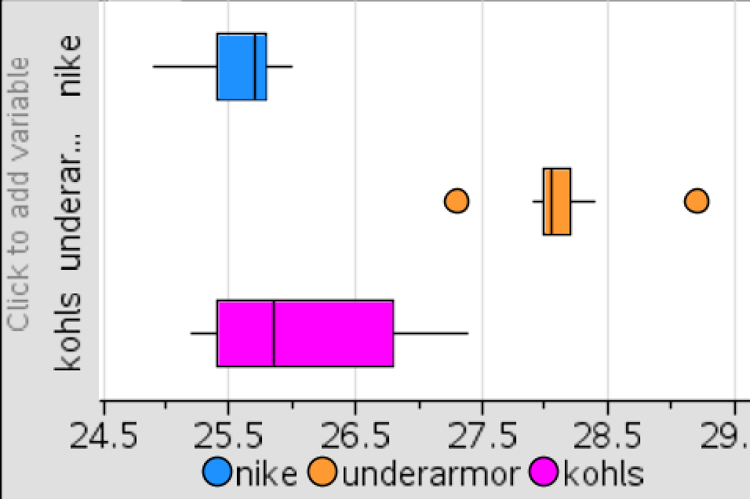
Box Plots
Minimum: 24.9
Q₁: 25.4
Median: 25.7
Q₃: 25.8
Maximum: 26
Minimum : 27.3
Q₁: 28
Median: 28.05
Q₃: 28.2
Maximum: 29.2
Minimum : 25.2
Q₁: 25.4
Median: 25.85
Q₃: 26.8
Maximum: 27.4

Slide 21
Box Plots Explained
Notice that the Under Armor inner quartile range (IQR) or “box” does NOT overlap with either the Nike IQR or the Kohl’s IQR. This indicates statistical significance, meaning that the data most likely did not happen by chance alone.
In this case, it can be inferred that Under Armor tends to make the wastes of their shorts larger than either of the other brands.

Slide 22
Box Plots Explained
Nike’s box plot seemed closest to the average waist size
Kohl’s had largest box plot
Had the largest range of data
Under Armor was the smallest box plot
Contained two outliers
Farthest away from average size waist
Again Nike seems like the most accurate brand. The next slides will either support this claim or go against it.

Slide 23
Truest to Size
Nike had the box plot closest to the average waist size of 25
The variance was the smallest, and the deviation was smallest as well
Its mean/average was closest to 25, it was 25.6
Kohl’s had the biggest box plot
Kohl’s also had the largest deviation and variance
Under Armor had the smallest box plot, yet it was not closest to the average waist size of 25
The average/mean was the largest at 28.13

Slide 24
Conclusion
Only one set of data had outliers, which was Under Armor.
The hypothesis was that Nike would be the most accurate because it was most expensive.
The hypothesis was CORRECT because Nike’s data was closest to the average waist size of 25.

Slide 25
Advice to Shoppers
The data showed that buying the more expensive product proved to be the product with the best quality.
Under Armor tended to make their shorts larger, so go with a size smaller than you would normally wear, if you plan on purchasing this brand.
Nike, the more expensive brand, seems to be a better choice than the less expensive brands. However, the second most accurate was the least expensive, Kohl’s. It was slightly larger than Nike, only by a few centimeters.
When shopping in the future, try to stick to trusted brands or stores for the most reliable product.

Slide 26
Advice for Manufacturers
It was obvious that the data was not very consistent for all the brands recorded.
Mass-manufacturing allows a lot of products to be made quickly; however, it is not always very accurate.
Mass-manufacturing may cause the accuracy of the shorts to decrease. They should make sure all the equipment is up to date and running properly for the best products. Another thing that should be consider is slowing down the process. Remember, “Quality over quantity!”

Slide 27
Citations
"Women's Sizing Charts." Women's Sizing Charts. N.p., n.d. Web. 09 May 2016.
Nike Logo. N.d. Web. 9 May 2016 <https://static.festisite.com/static/partylogo/img/logos/nike.png>.
Under Armor Logo. N.d. Web. 9 May 2016 <https://upload.wikimedia.org/wikipedia/commons/thumb/4/44/Under_armour_logo.svg/500px-Under_armour_logo.svg.png>.
Kohls Logo. N.d. Web. 9 May 2016. <http://vignette4.wikia.nocookie.net/camphalfbloodroleplay/images/7/72/Kohls-logo.png/revision/latest?cb=20140622213627>.
Stack of Money. N.d. Web. 9 May 2016. <http://images.clipartpanda.com/stack-of-money-clipart-RcdRgpeei.png>.
Stack of Jeans. N.d. Web. 7 May 2016. <http://www.99to499.com/wp/wp-content/uploads/2015/10/STACK-OF-JEANS-psd70308.png>.
Measure Tape. N.d. Web. 11 May 2016. <http://www.moonliteblinds.com/wp-content/uploads/2015/04/measuretape-png.png>.
Dick's Sporting Goods. N.d. Web. 11 May 2016. <https://cdn-static.findly.com/wp-content/uploads/sites/86/2015/08/Storefront-Full_MG_1333.jpg>.
Macomb Mall. N.d. Web. 11 May 2016. <http://www.gannett-cdn.com/-mm-/132ea4b94a00c40a781cedd27f9670f7d72234dd/c=216-0-3352-2352&r=x404&c=534x401/local/- /media/2015/06/03/DetroitNews/B99276427Z.1_20150603204536_000_GU0H5H4N.1-0.jpg>.

