Slide 1
Compare and contrast the differences and similarities between the mean and median of a data set.

Slide 2
Both the mean and the median are measures of central tendency.
The mean is the average of all of the data points in a data set.
The median is the middle value of a data set when all the data points are arranged in order of magnitude.

Slide 3
Give the five-number summary for the following data set:
7, 6, 10, 12, 15, 18, 4, 16, 9, 3

Slide 4
Min: 3 Q₁: 6 Median: 9.5 Q₃: 15 Max: 18

Slide 5
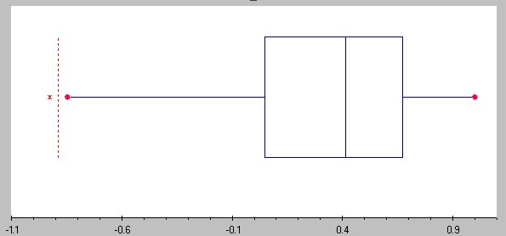
Describe the boxplot in terms of symmetry or skewness (whichever is appropriate).

Slide 6
The boxplot is left skewed (negatively skewed).

Slide 7
Find the Tukey fences and any outliers in the data set. 24, 27, 2, 32, 26, 21, 59, 39, 24, 25, 31, 21, 34, 26, 23

Slide 8
Tukey fences: [9.5, 45.5] Outliers: 2, 59

Slide 9
For normally distributed data, how much of the data points are within one standard deviation of the mean?

Slide 10
For normally distributed data, how much of the data points are within one standard deviation of the mean? 68%

Slide 11
Some friends have gotten together and want to figure out who can solve a Rubik's cube the fastest. They record the time (in seconds) it takes each of them to solve it as follows: 54, 43, 62, 60, 65, 67, 50, 52, 55.
Make a histogram with bar widths of 10 (1-10, 11-20, etc.) using this data.

Slide 12
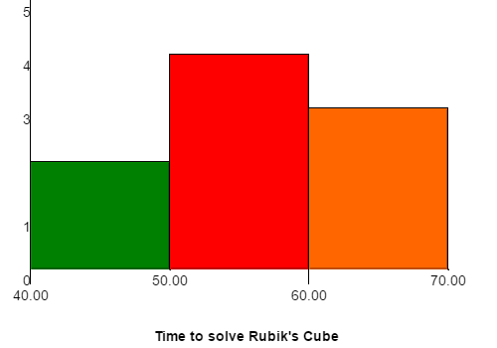
(s)
2 4 3

Slide 13
Make a box plot using the following data:
9, 15, 16, 22, 4, 10, 11, 17, 12, 9, 13, 6, 5

Slide 14
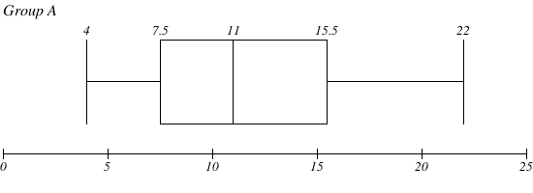

Slide 15
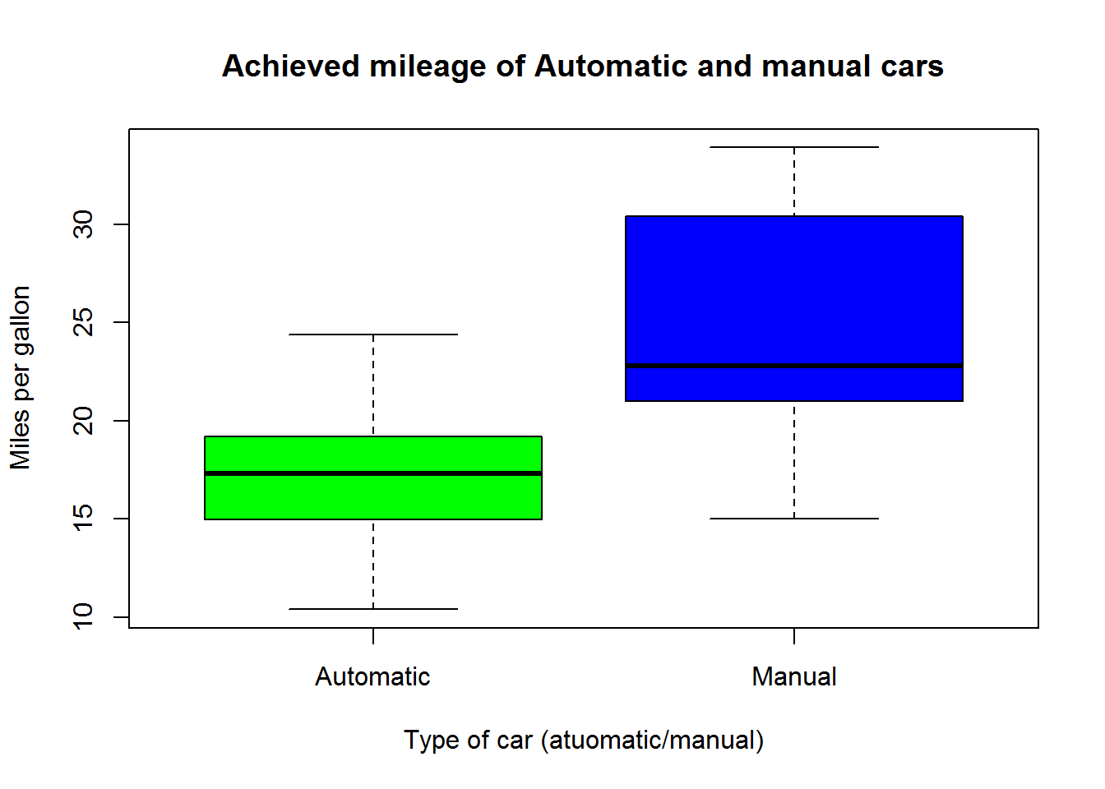
Use the rule of thumb for boxplots to make a comparison between the automatic and manual cars.

Slide 16
Because the boxes do not overlap, there is a statistical difference between the Automatic and Manual cars. We can conclude that the manual cars being tested get more miles per gallon than the automatic ones.

Slide 17
Find the sample standard deviation for the following data set by hand: 1, 5 , 5, 7, 8, 8, 8

Slide 18
Find the sample standard deviation for the following data set: 1, 5 , 5, 7, 8, 8, 8 about 2.58

Slide 19
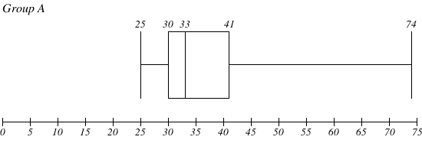
How much of the data points are less than 41?

Slide 20
75%

Slide 21
The distribution of heights of adult American women is approximately normal with a mean of 64 in and a standard deviation of 2.3 in. What percent of women are between 59.4 in and 66.3 in tall?

Slide 22
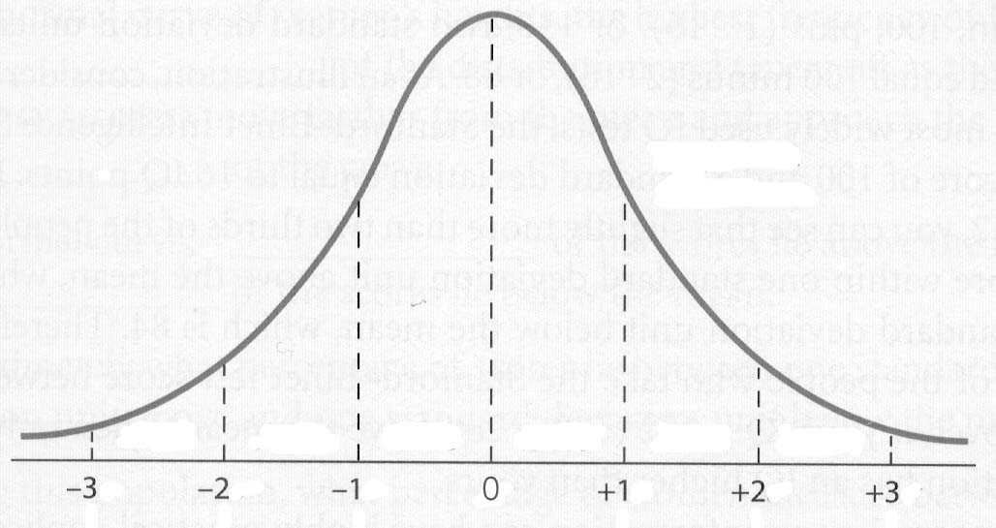
13.5% + 34% +34 % = 71.5%
64
34%
34%
61.7
66.3
13.5%
59.4
57.1
68.6
70.9
S_{x}
S_{x}
S_{x}
$$\overline{x}$$
S_{x}
S_{x}
S_{x}

